Slide 1

M5 – Visual Recognition
Project: GAN
Members: Guillem Capellera, Johnny Núñez, Anna Oliveras
​
Notes:
My name is
What?
My name is
Who?
My name is
Chika-chika
Slim Shady

Slide 2
Task 1: Why GANs?
In this task we imagine that we have a dataset X and we wish to generate new samples from it.
We analyze why you would choose a GAN over any other type of generative network for this task. Moreover, we discuss when a GAN may not be an appropriate choice.

Slide 3
Task 1: GANs → Why should we use them ?
A Generative Adversarial Network (GAN) would be an appropriate choice for generating new samples from a dataset X for several reasons:
High-quality samples: GANs are known for their ability to generate high-quality samples that closely resemble the real data distribution. This is because GANs consist of two neural networks, a generator and a discriminator, that compete with each other in a zero-sum game. The generator aims to create samples that can fool the discriminator, while the discriminator tries to differentiate between real and generated samples. This adversarial process leads to an improved generator capable of producing realistic samples.
Handling multimodal data: GANs are particularly well-suited for generating samples from multimodal data distributions, as the generator learns to capture the different modes of the data. The adversarial training process encourages the generator to explore different regions in the data distribution and produce diverse samples.
Implicit density estimation: Unlike some generative models, GANs do not explicitly model the probability distribution of the data. Instead, they learn to generate samples directly from the data distribution. This can be advantageous in cases where explicit density estimation is computationally expensive or infeasible.
Flexibility: GANs can be applied to a wide range of data types, including images, audio, and text. They can also be easily combined with other models, such as autoencoders and reinforcement learning, to tackle specific tasks or constraints.

Slide 4
Task 1: GANs → When they are not the best choice?
There are certain scenarios in which GANs might not be the best choice:
Sampling speed: GANs can be slower at generating samples compared to other generative models, such as Variational Autoencoders (VAEs) or autoregressive models. This is because GANs require a forward pass through both the generator and discriminator networks. If sampling speed is a critical constraint, a faster generative model might be more appropriate.
Data privacy: In cases where data privacy is a concern, using GANs might introduce risks. Since the generator learns to closely mimic the data distribution, it could potentially generate samples that reveal sensitive information about the original data. In such scenarios, privacy-preserving techniques, like differential privacy, should be considered when training the GAN or using an alternative generative model that offers better privacy guarantees.
Training stability: GANs can be challenging to train due to the adversarial nature of the learning process. This may lead to issues like mode collapse, where the generator produces only a limited variety of samples. In such cases, exploring other generative models or incorporating modifications like Wasserstein GANs or spectral normalization may be necessary.

Slide 5
Task 2: Training our 1D GAN
After the convergence failure seen in the notebook for the basic model (Normal distribution), we will optimize the hyperparameters to make it easier for the network to approximate p_{data} but using a harder distribution (Laplacian).

Slide 6
Task 2: Hyperparameters
Optimizing hyperparameters is crucial for unlocking the true potential of Generative Adversarial Networks (GANs), enabling them to generate high-quality and diverse outputs, convergence, and achieve superior performance.
We will work with the Laplacian distribution and the following hyperparameters, as suggested in the notebook:
Num_epochs: the number of epochs to train our GAN.
Learning rate: the learning rate for both the Generator and Discriminator.
D_repeats: we train the generator every d_repeats.
Hidden_dim Generator: How many neurons in the hidden_layer of the Generator.
Hidden_dim Discriminator: How many neurons in the hidden_layer of the Discriminator.
Latent dim: define is the dimensionality of this vector space.
Batch_size: Size of batches for our training.
In addition to these, we also include this extra parameter in our search :
StepLR scheduler: Learning rate scheduler for our learning reate decay

Slide 7
Task 2: Hyperparameters
In order to analyze the hyperparameters effect on the results we followed the following order, using the best parameter found in each step for the following experiments (the default value is shown in brackets):
Learning Rate & Step LR scheduler (3e⁻⁴)
. . .
Latent dimension (5)
Batch_size (1024)
Hidden dimension of the Generator & Discriminator (15 and 25 respectively)
Number of epochs (100)
Discriminator repeats (1)
. . .

Slide 8
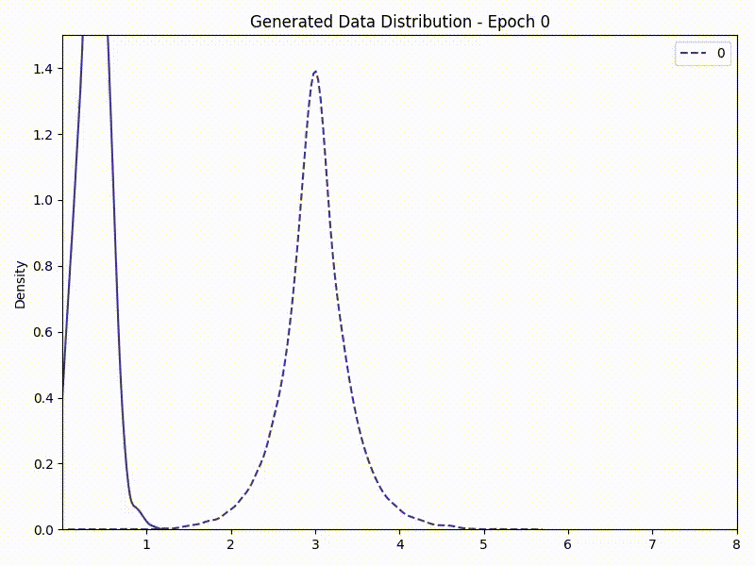
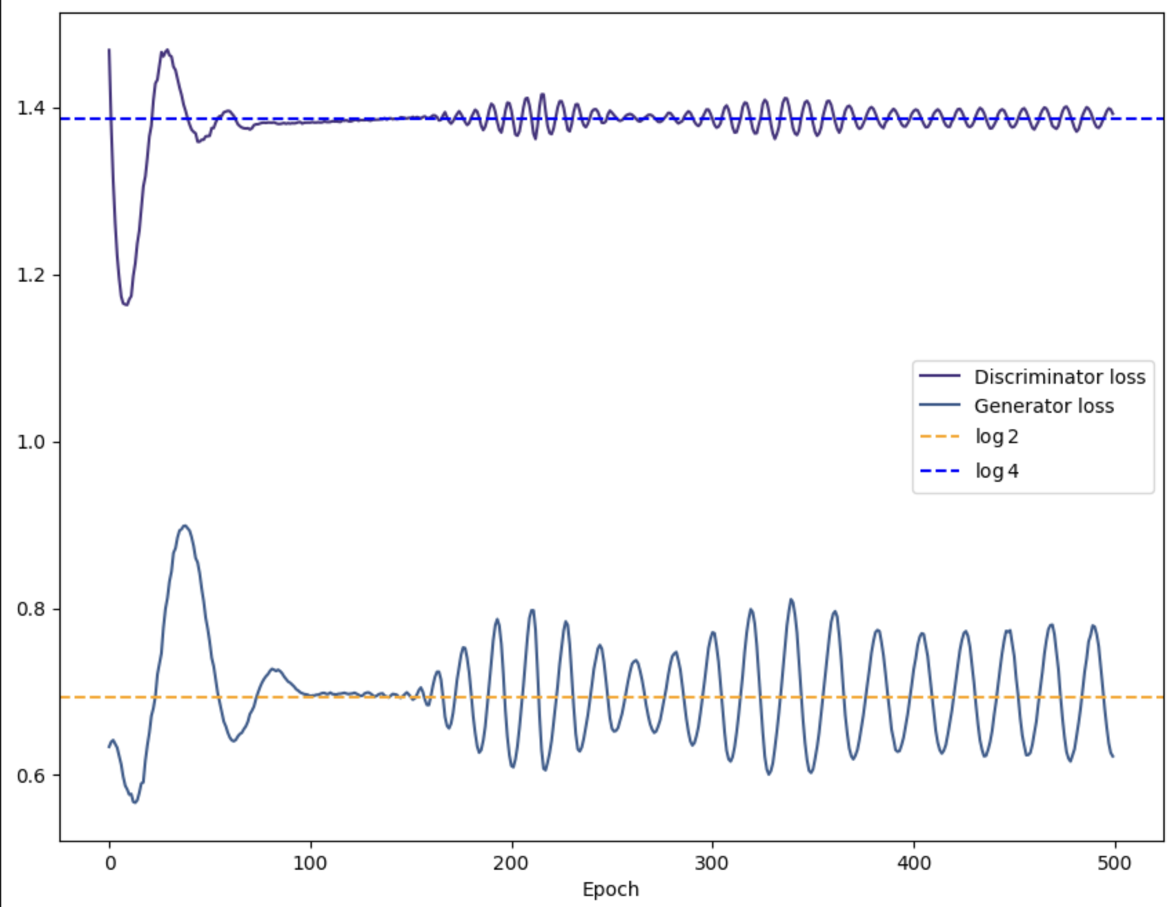
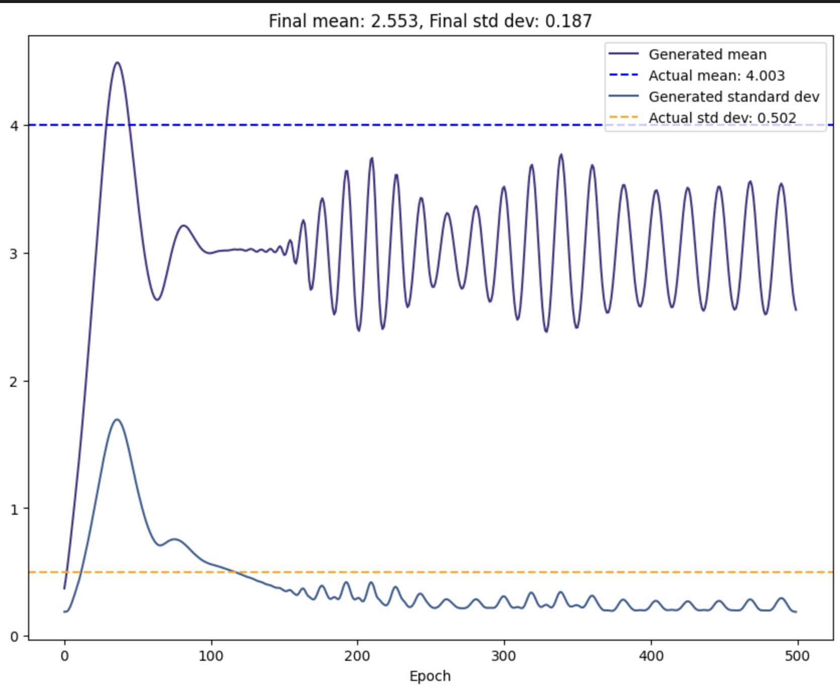
Task 2: Default Hyperparameters
Discriminative Loss
We see that very bad results with the default hyperparameters.
The training is very unstable and it is not able to converge to the desired distribution.
Thus, we will try to find better parameters in the following slides.
*From now one, we will not show the loss plot since it is not always representative of the quality of the results. Although the loss may apparently stabilize in some cases, we have seen in the notebook how this does not mean that we have reached the desired optimal value. Thus, the generated data may not be similar to the actual data.

Slide 9
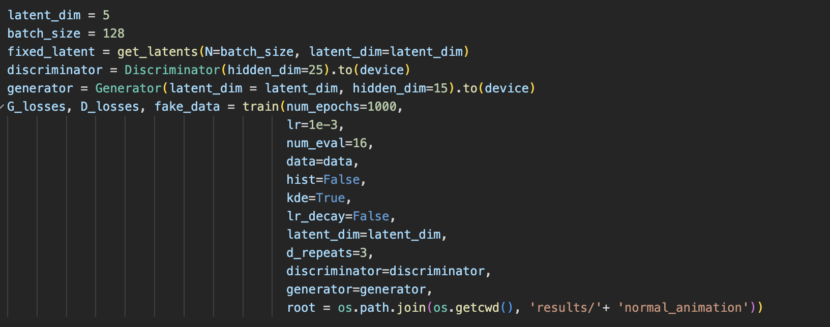
Task 2: Pipeline for each distribution

Slide 10
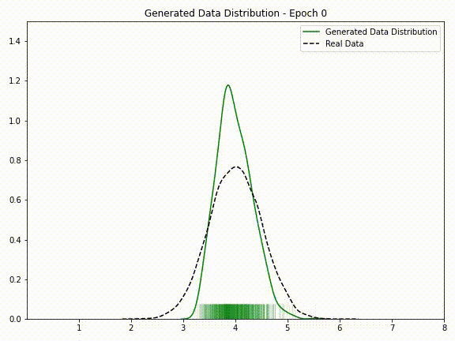
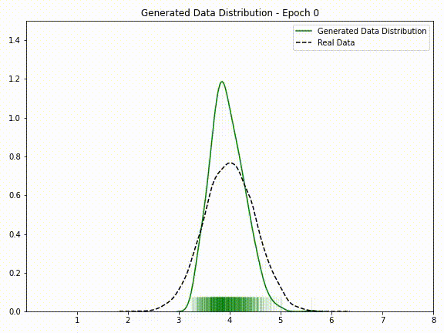
Task 2: Learning Rate & Step Learning Rate Scheduler
Step LR increase
Step LR decay
First we tested different learning rates but then we decided to use a LR scheduler to help the convergence. The LR used for the schedulers is 10⁻³. As expected, increasing the learning rate produces instability. Lowing the learning rate produces more stability on the final epochs.
*Note that we implemented the scheduler since the initial tests, so here we are showing it for the normal distribution.

Slide 11
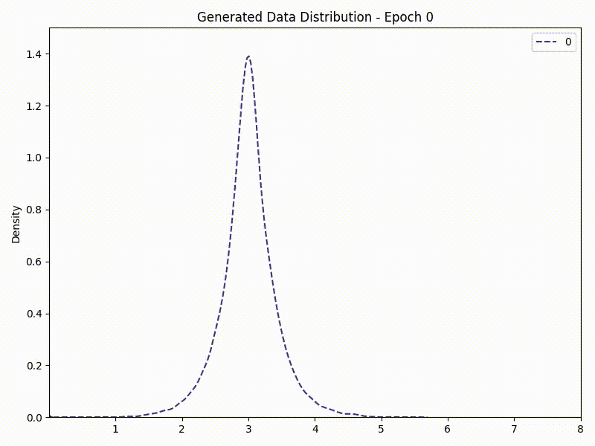
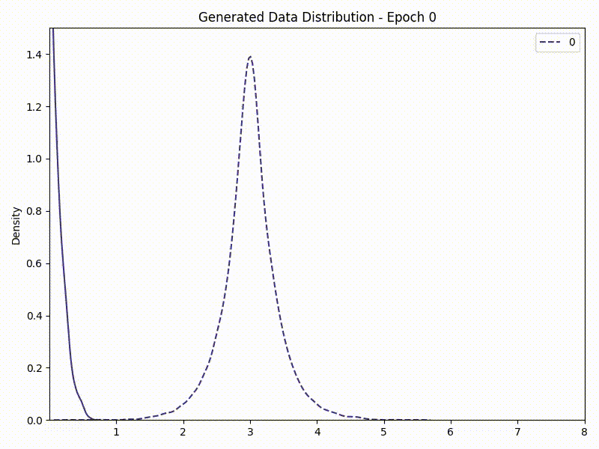
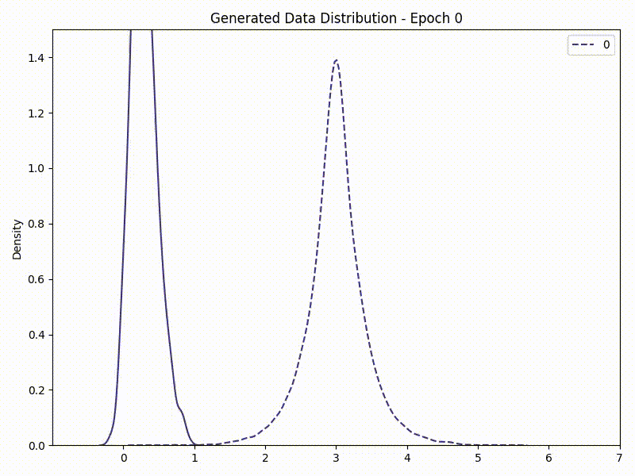
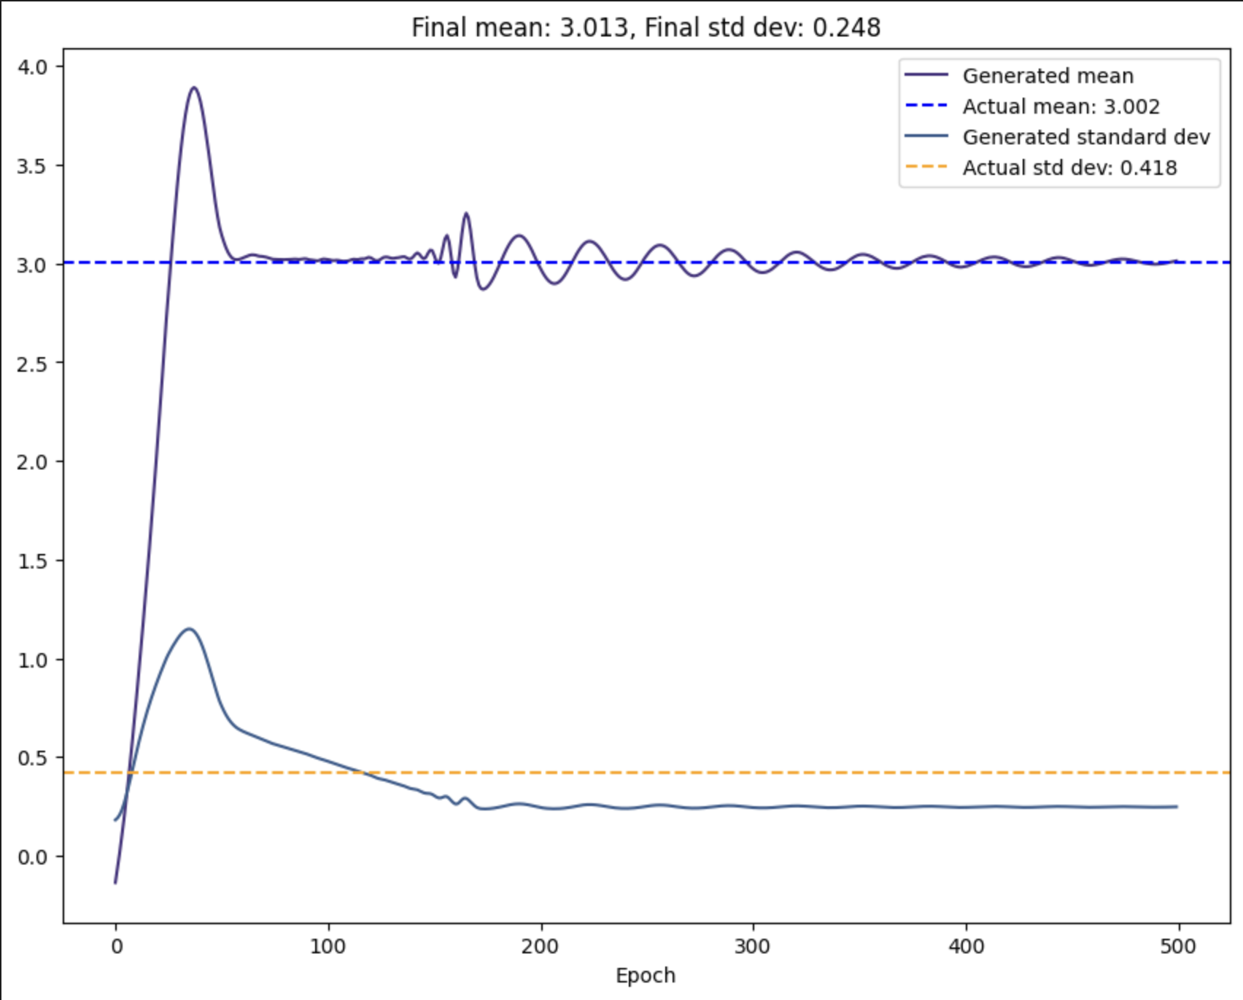
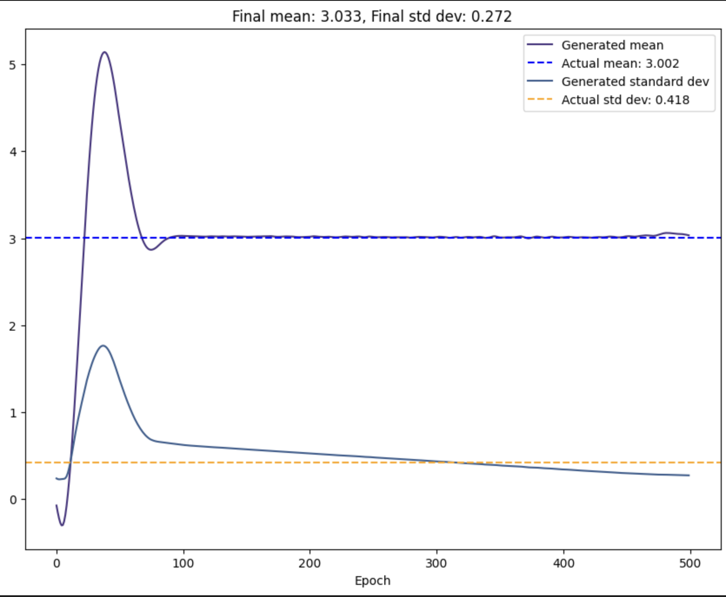
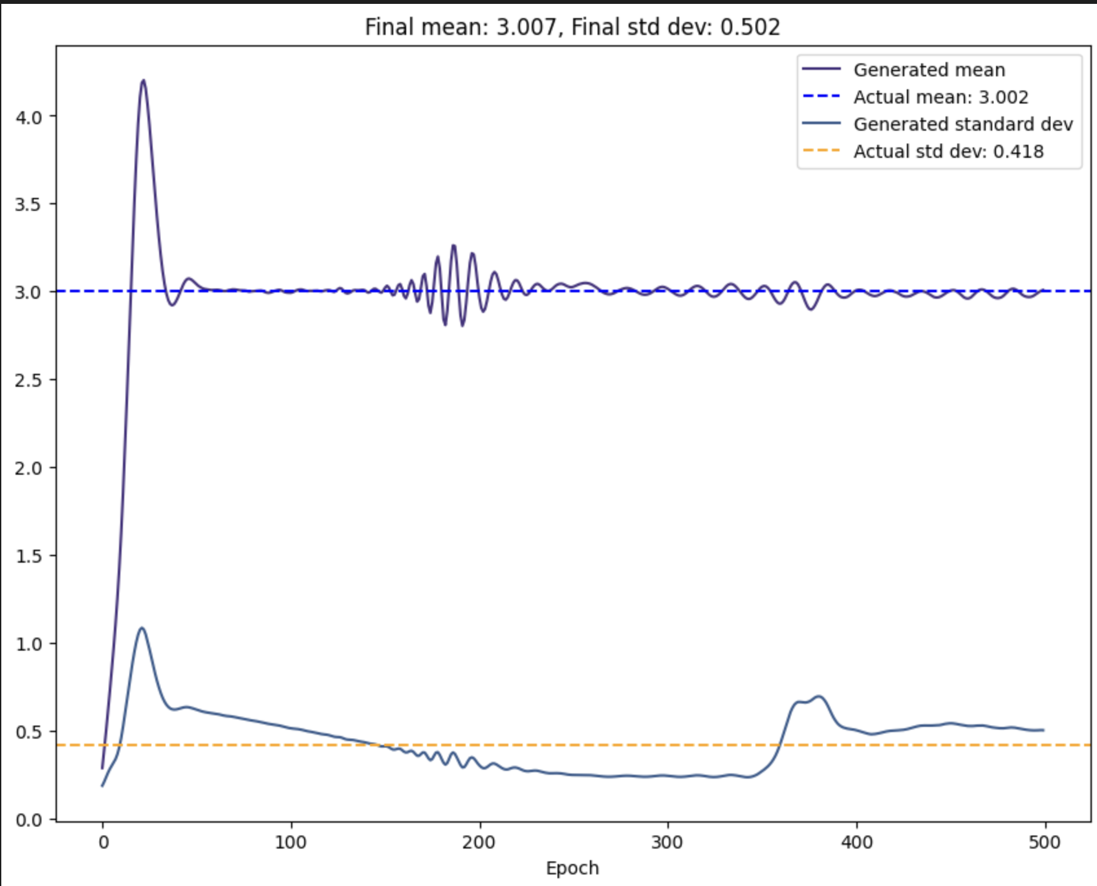
Task 2: Latent dimension
Dim 8
Dim 24
Dim 64
A 24-dimensional latent space is well-suited to capture the complexity of the one-dimensional data you are working with. A smaller dimensionality, such as 8, may not provide enough flexibility to generate diverse samples, while a higher dimensionality, such as 64, may lead to mode collapse due to overfitting.

Slide 12
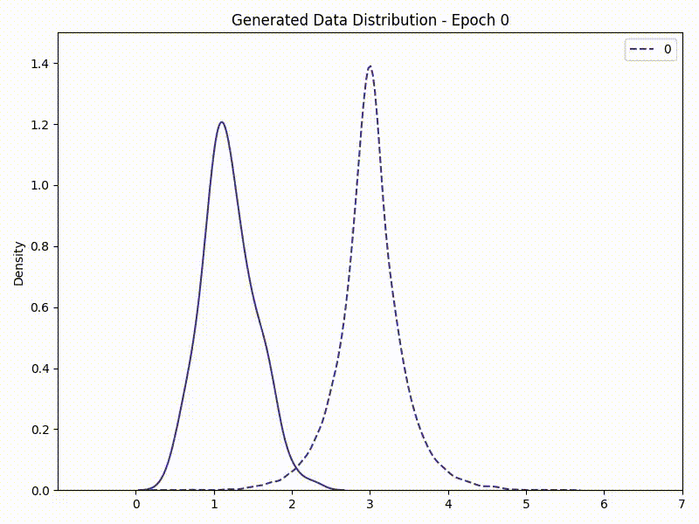
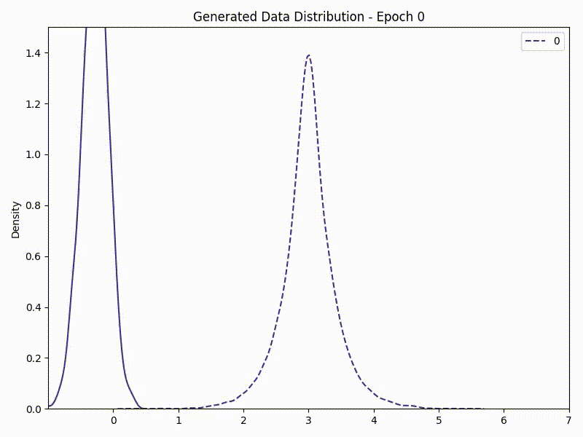
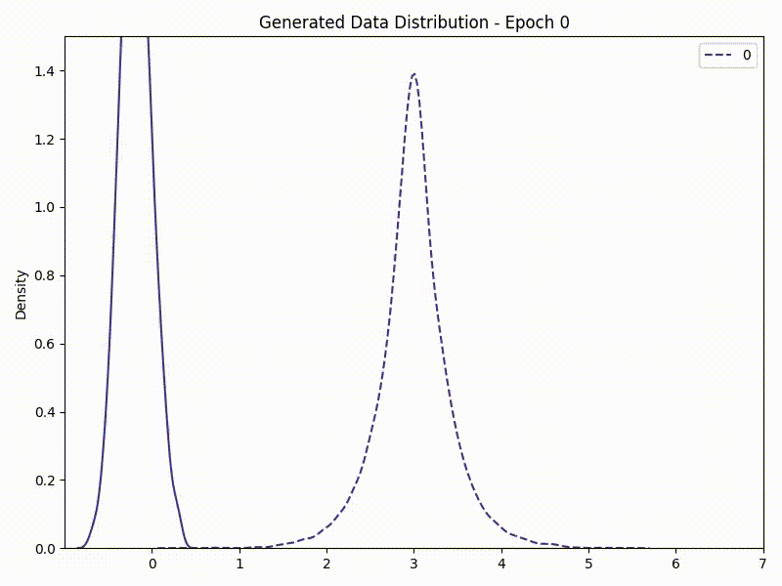
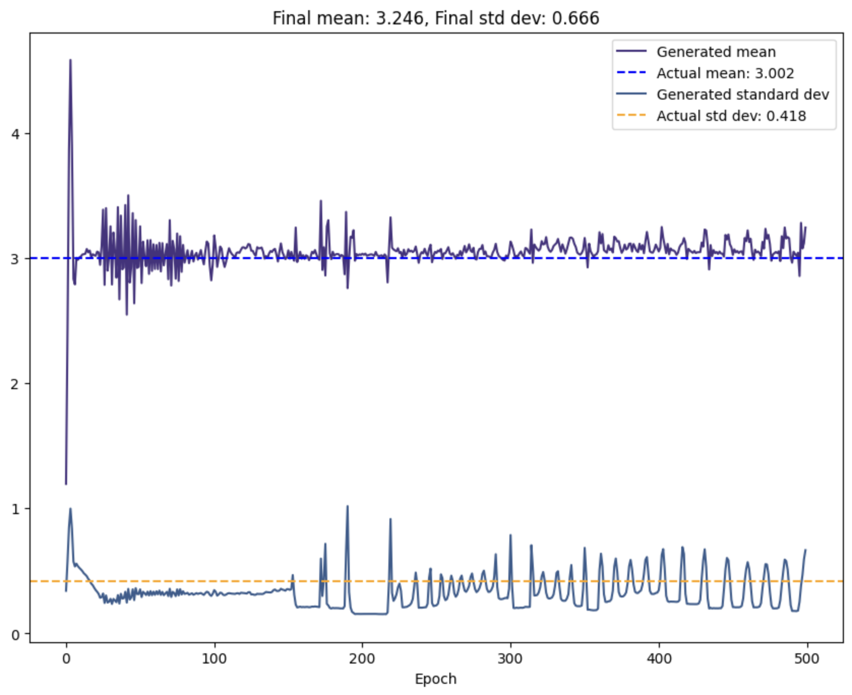
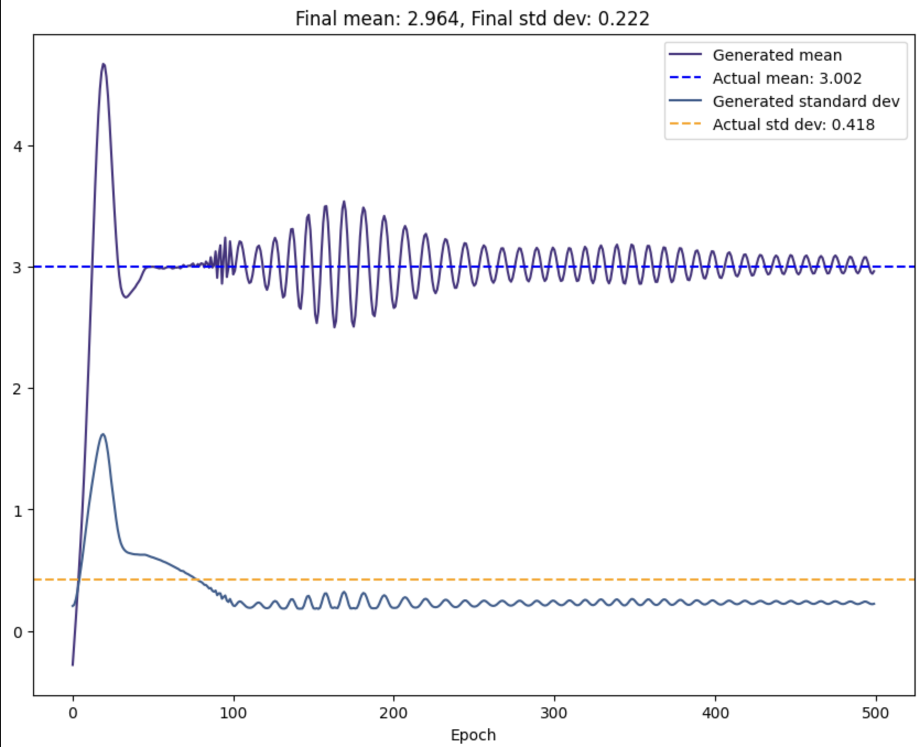
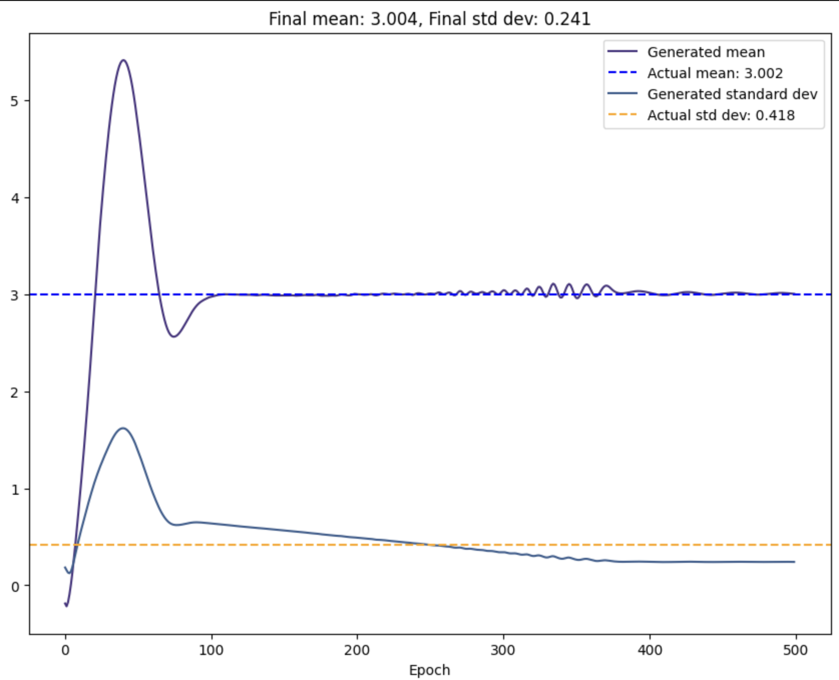
Task 2: Batch size
128
512
1024
A batch size of 128 and 512 are too small, they can lead to unstable training and oscillations in the loss function. On the other hand, a batch size of 1024 gives more stability and clear convergence of the mean value.

Slide 13
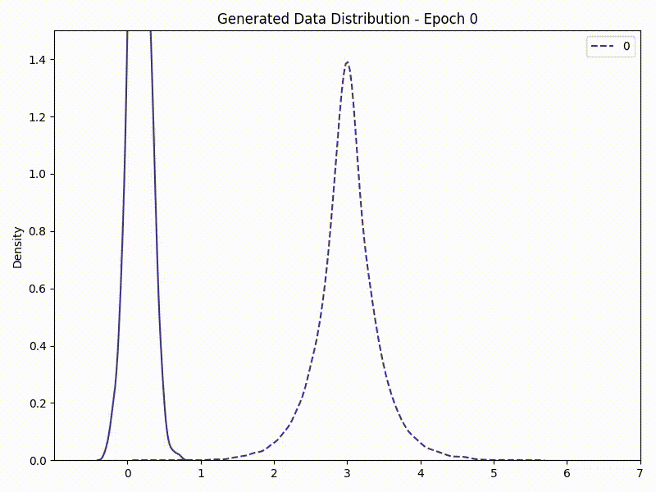
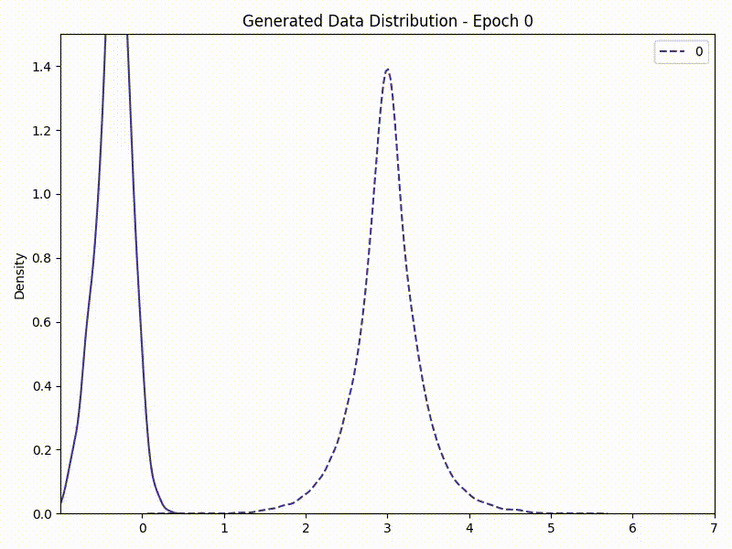
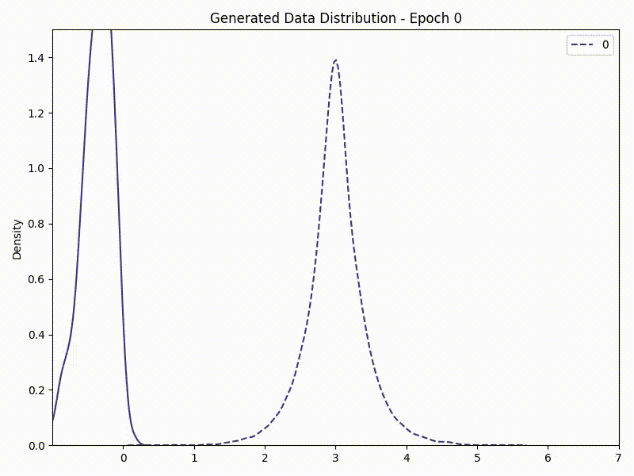
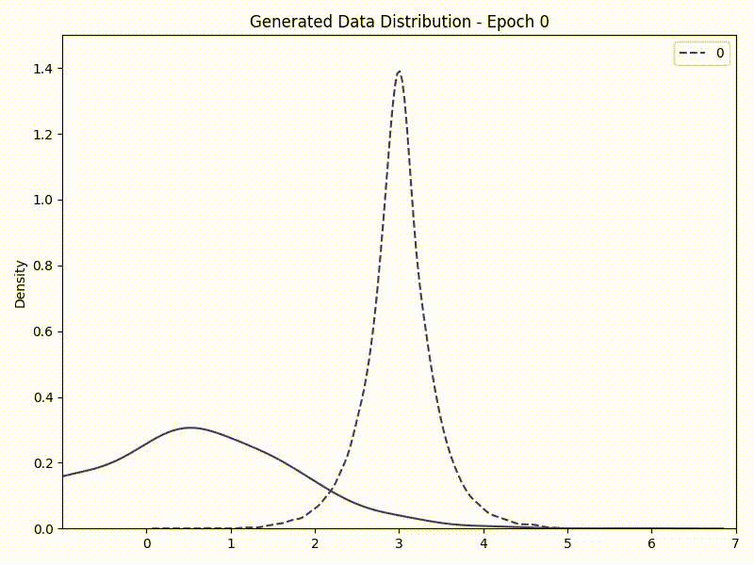
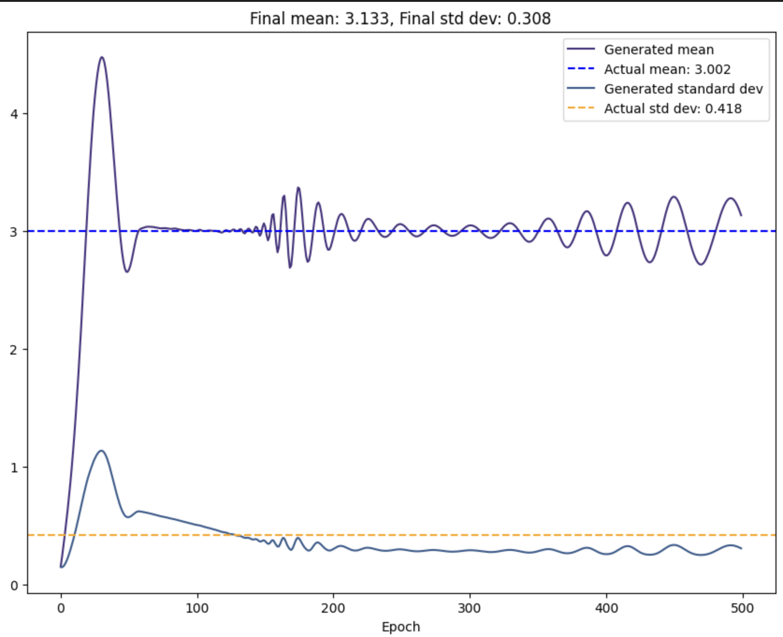
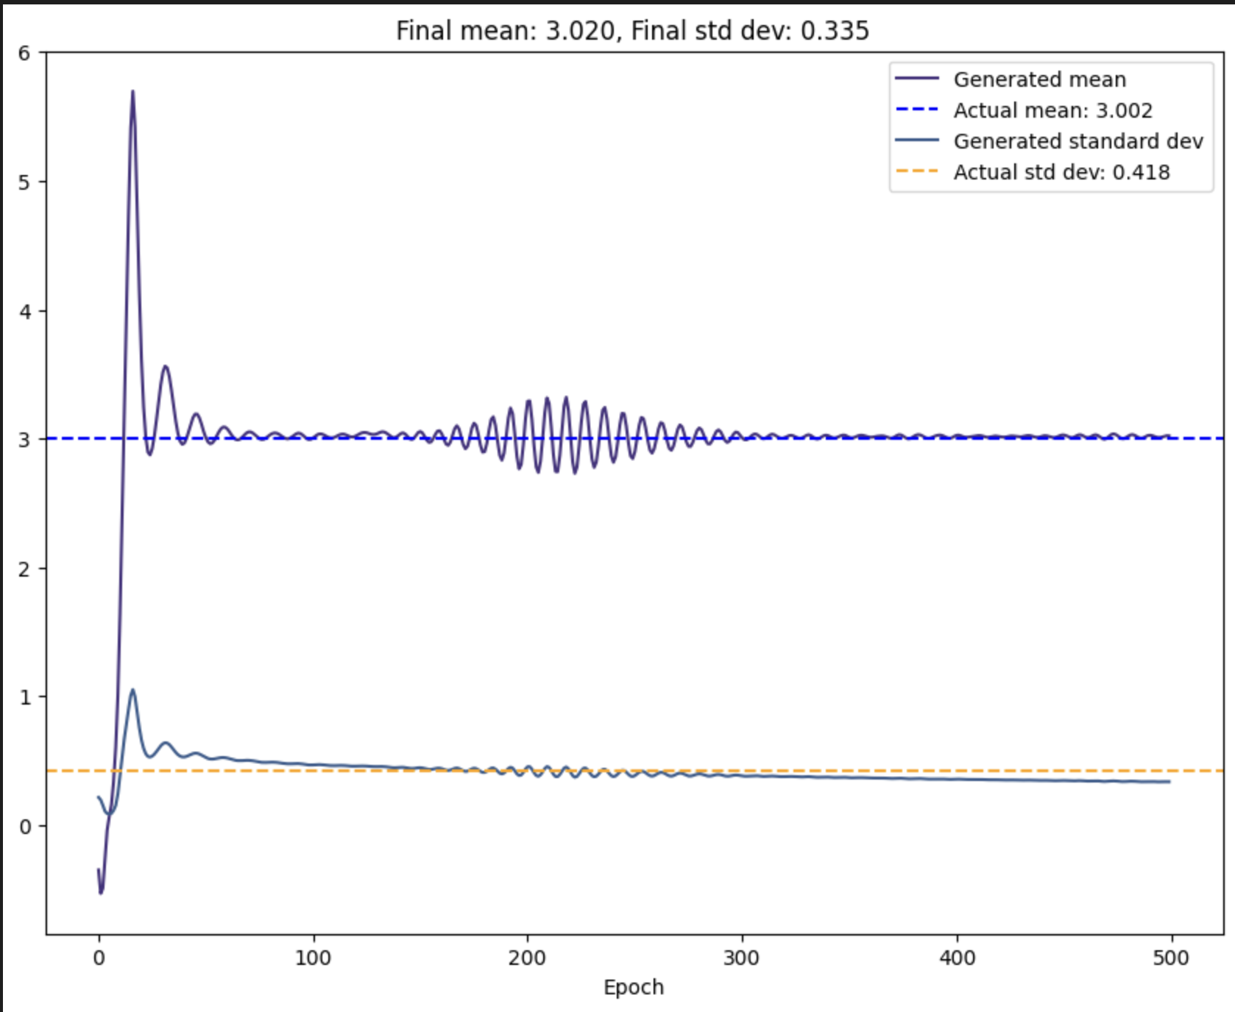
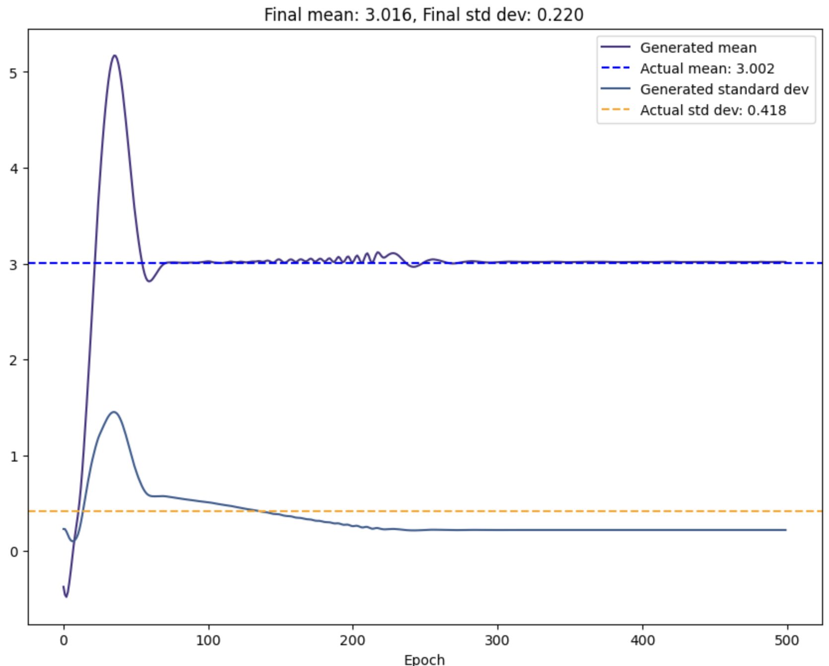
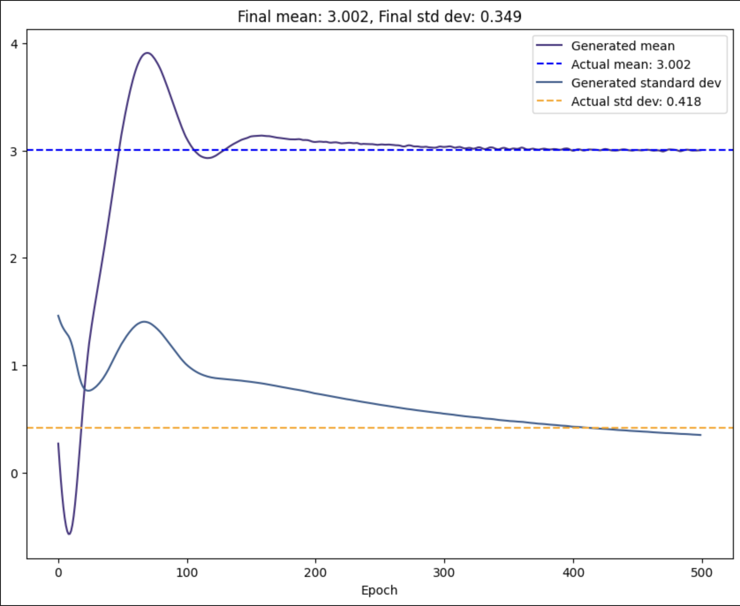
Task 2: Hidden dimensions of the Generator / Discriminator
15 vs 96
96 vs 25
32 vs 64
15 vs 25
Using a higher dimensionality for the discriminator than for the generator (25 and 15, respectively) seems to be the best option. One possible explanation for this is that the higher-dimensional discriminator can better capture the complex patterns and features present in the real data, while the lower-dimensional generator can learn a more compact and expressive representation of the data that still captures the most important features.

Slide 14
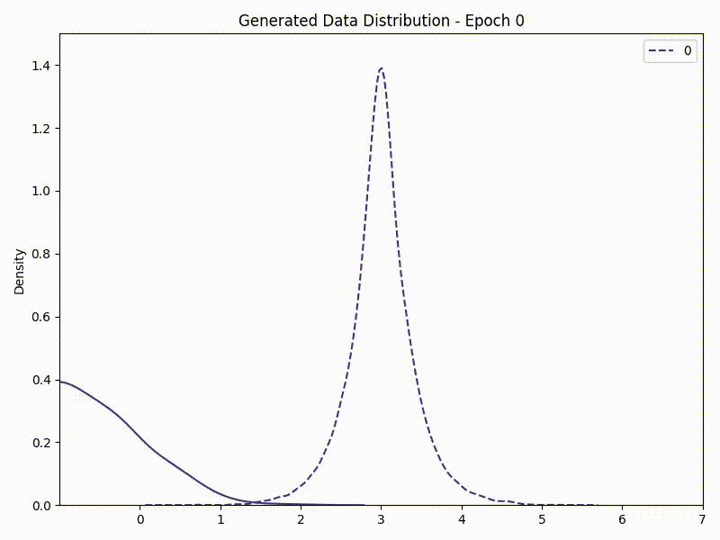
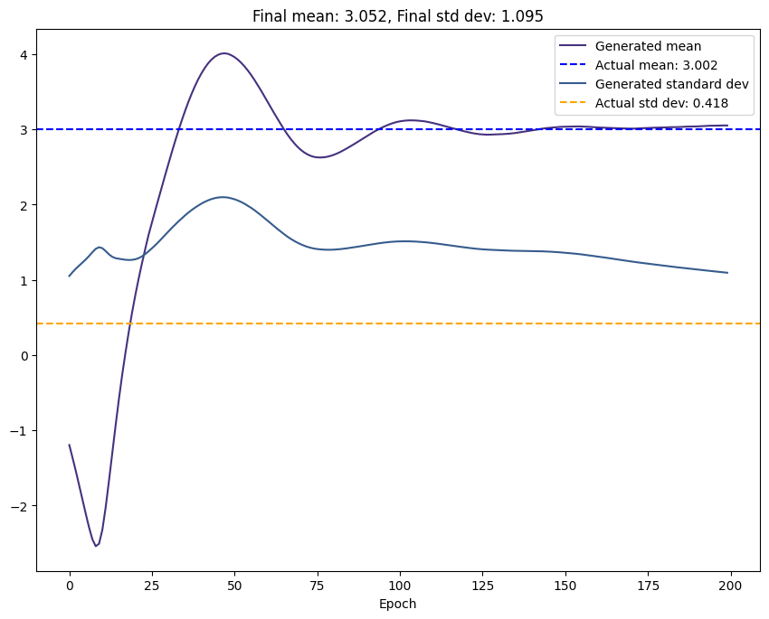
Task 2: Number of epochs
200
500
When the number of epochs is too low, the generator may not have sufficient opportunities to learn the underlying distribution of the data and generate high-quality samples that match this distribution. On the other hand, when the number of epochs is high, the generator has more opportunities to improve and learn the underlying distribution of the data, which can lead to better quality generated samples.

Slide 15
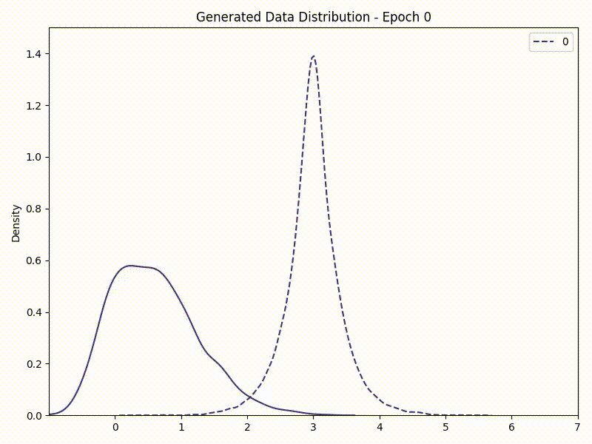
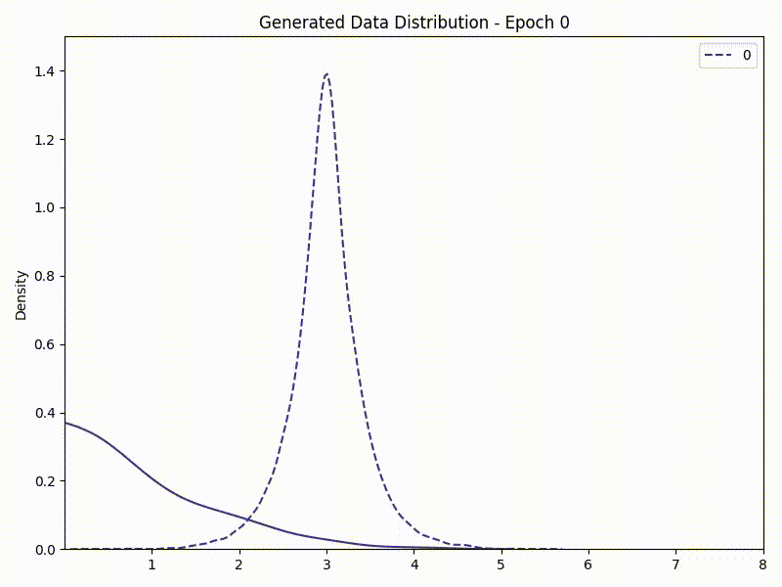
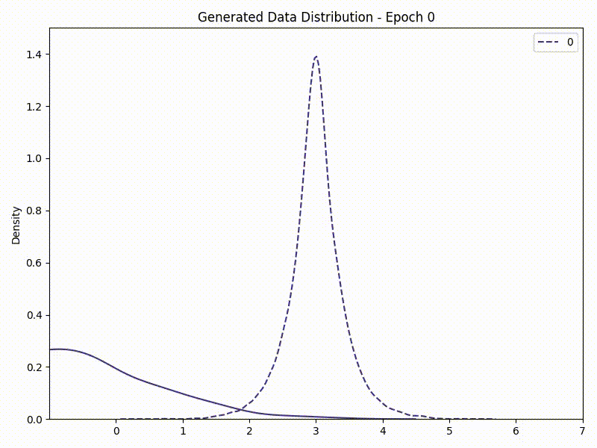
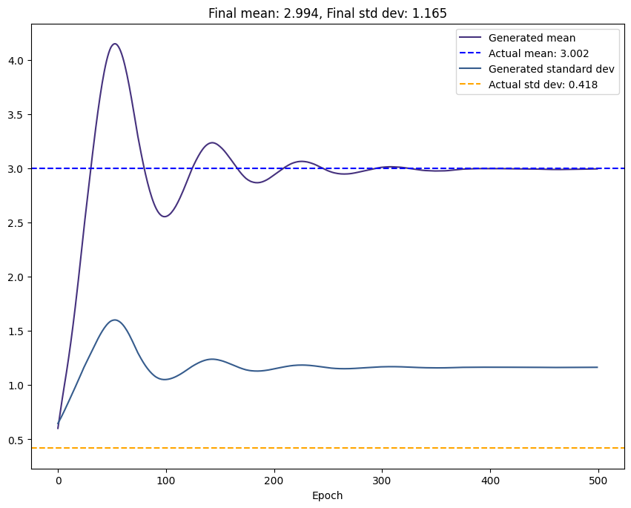
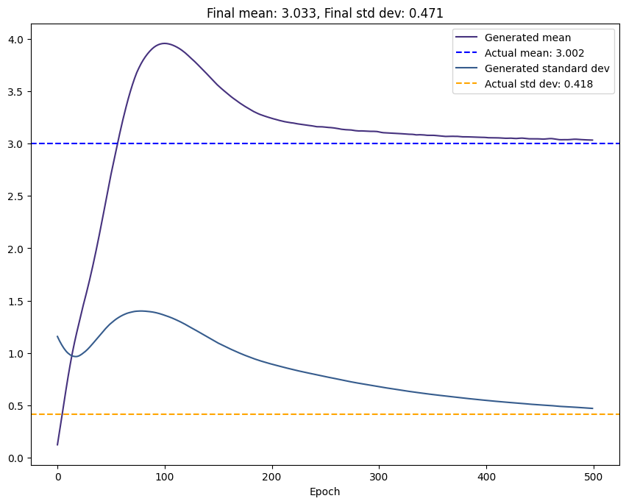
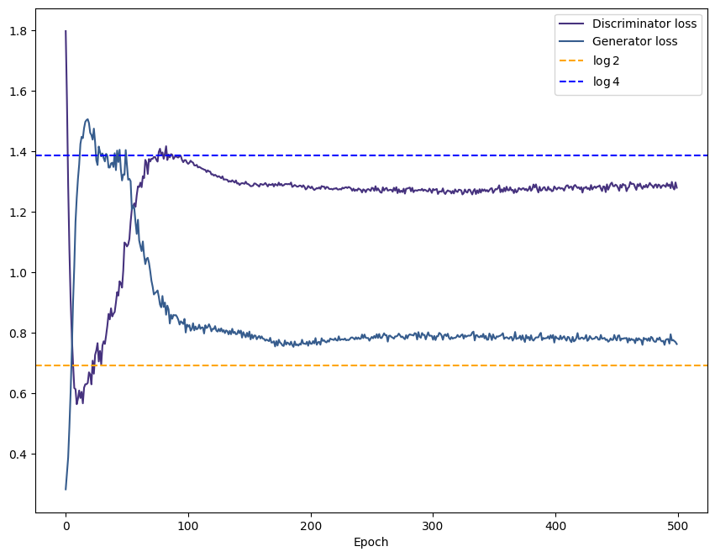
Task 2: D repeats
1
2
3
4
It seems that the best value for d_repeats is 3. One possible explanation for this is that it strikes a good balance between allowing the discriminator to learn and update its parameters sufficiently, while also allowing the generator to make progress in generating realistic samples. With d_repeats set to 3, the discriminator has enough opportunities to learn from the data and update its parameters, while the generator has enough opportunities to adjust its parameters to produce better samples.

Slide 16
Conclusions

Slide 17
Generative Adversarial Networks (GANs) are a powerful choice for generating new samples from a dataset due to their ability to produce high-quality samples, handle multimodal data, perform implicit density estimation, and their flexibility to be combined with other models for specific tasks or constraints. GANs are well-suited for various data types and offer a unique approach to generative modeling through adversarial training.
Hyperparameters tuning is essential to achieve good results. We have seen that the key hyperparameters are:
Batch size → if it is big the training is more stable but it may not converge to the desired results, while if it is too small the training oscillates a lot.
The use of a LR scheduler makes it easier to train the GAN
The Discriminator repeats parameter repeats also affects a lot the results. If it is to big the network does not learn but if it is too small there may be overfitting
With bigger latent dimensions the GAN is able to learn more complex distributions but it gets to a point it does not help to increase the latent dimension
The balance between the number of hidden layers of the two networks is also important. Bad results are obtained if one of the two networks is much more powerful than the other one.
The Stochasticity is a problem to find the best hyperparameters → maybe using pytorch torch.use_deterministic_algorithms(True) could help.

